Slide 2
Native iOS Swift Apps with a cloud backend
BOA332
Sébastien Stormacq (him)
Developer Advocate, AWS

Slide 3
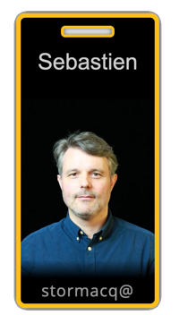
Who am I ?

Slide 4
What are we going to build ?

Slide 5
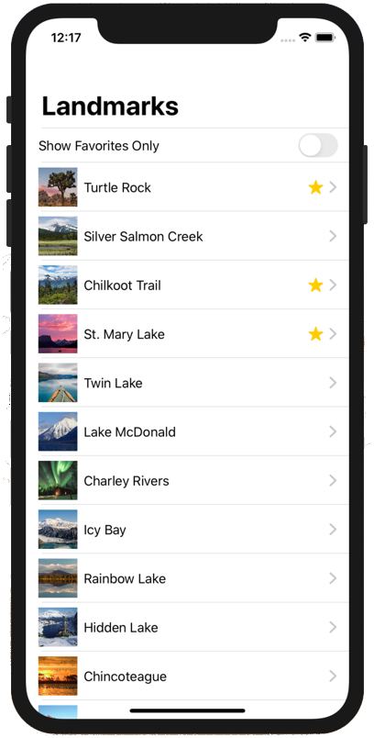

Slide 6


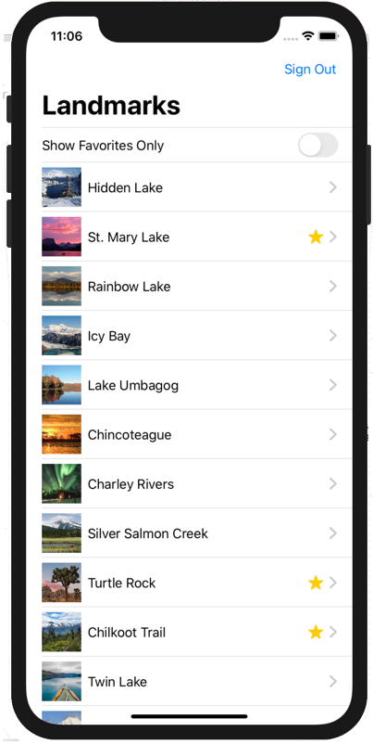



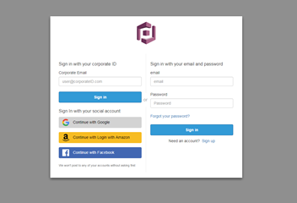

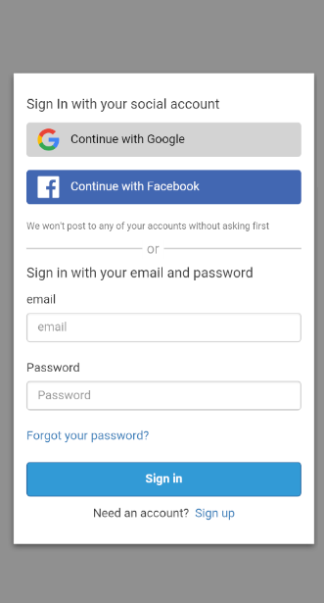


AWS Cloud
Cognito token
Amazon Cognito
Access serverless backend
AWS AppSync
Amazon DynamoDB
Temporary access key and secret key
Amazon Simple Storage Service
(Amazon S3)

Slide 7
Pre-requisites
Mac OS laptop + XCode 14 (we have USB keys)
Basic knowledge of the Swift programming language
Join the workshop at https://catalog.workshops.aws/join.

Slide 8
Getting started with this workshop
As a participant, you will have access to an AWS account with any optional pre-provisioned infrastructure and IAM policies needed to complete this workshop.
The AWS account will only be available for the duration of this workshop. You will lose access to the account thereafter.
Be sure to review the terms and conditions of the event. Do not upload any personal or confidential information in the account.

Slide 9
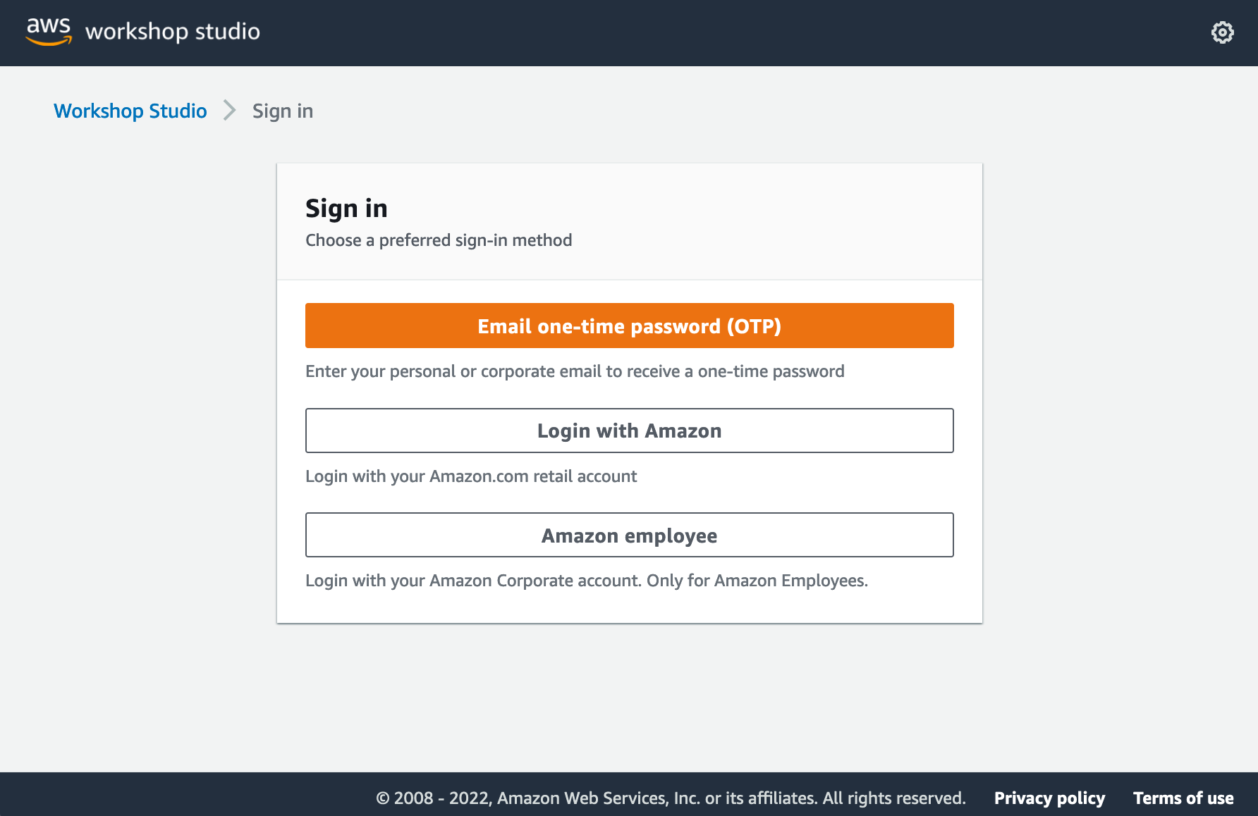
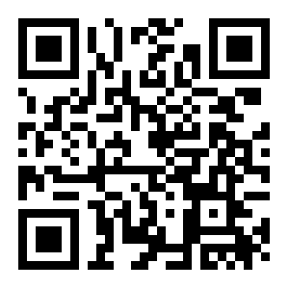
Step 1: Sign-In via your preferred method
https://catalog.workshops.aws/join

Slide 10
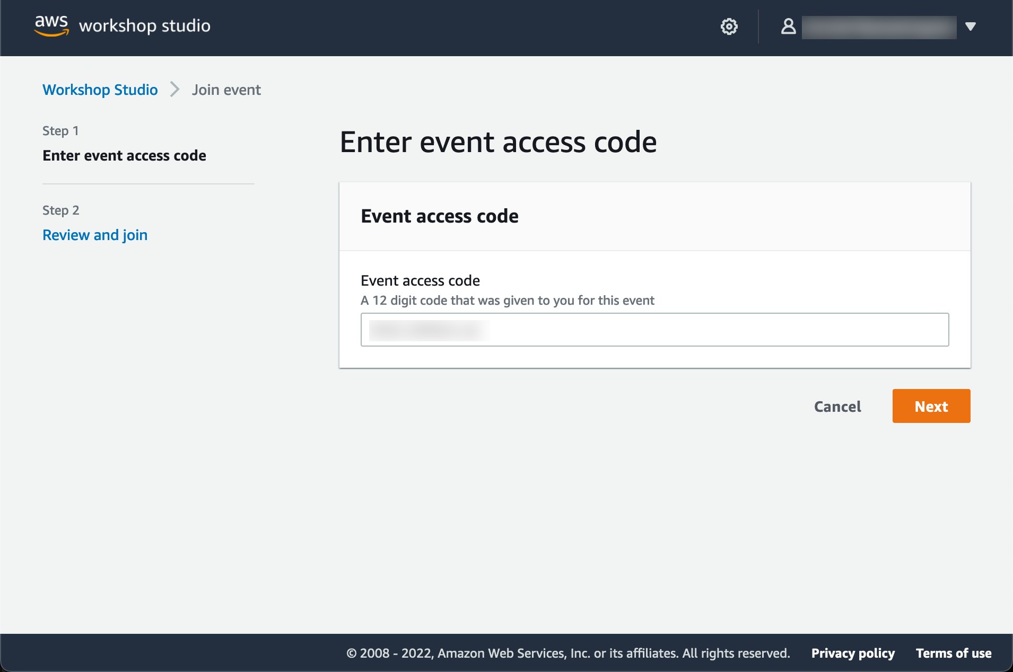
Step 2: Enter event access code
Enter 12 digit event access code. If you were given a one-click join link, you can skip this step.

Slide 11
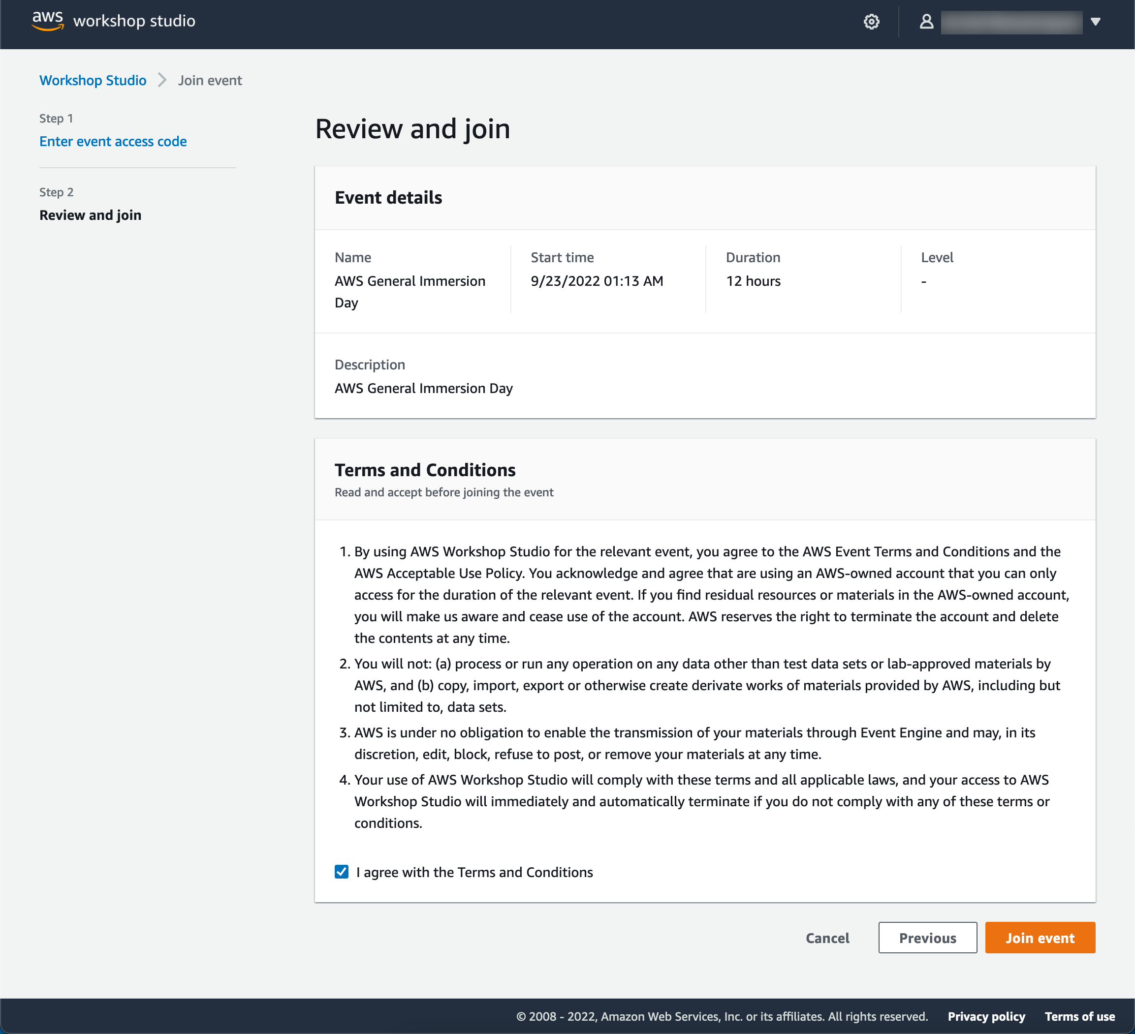
Step 3: Review terms and join event

Slide 12
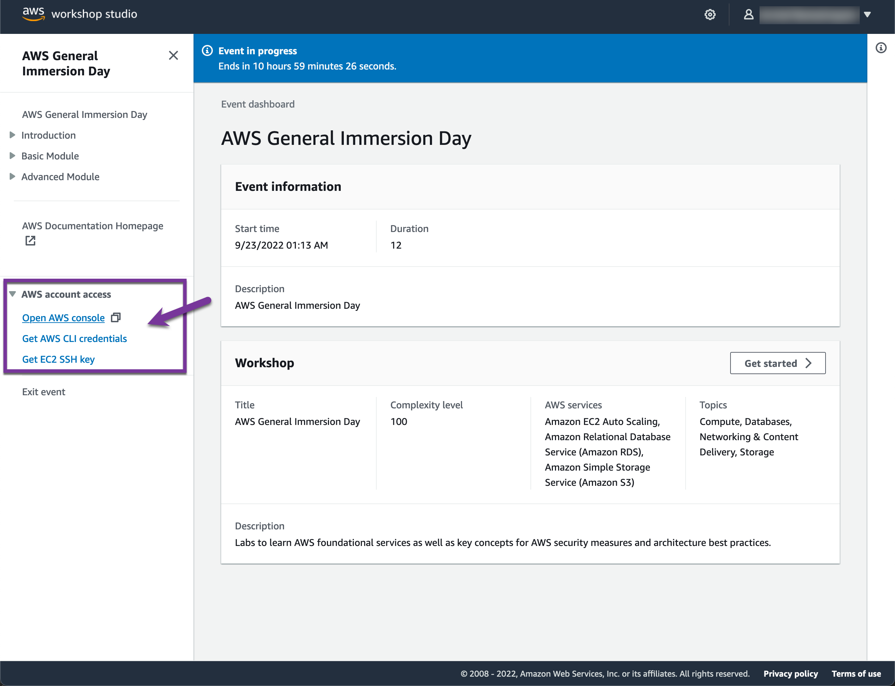
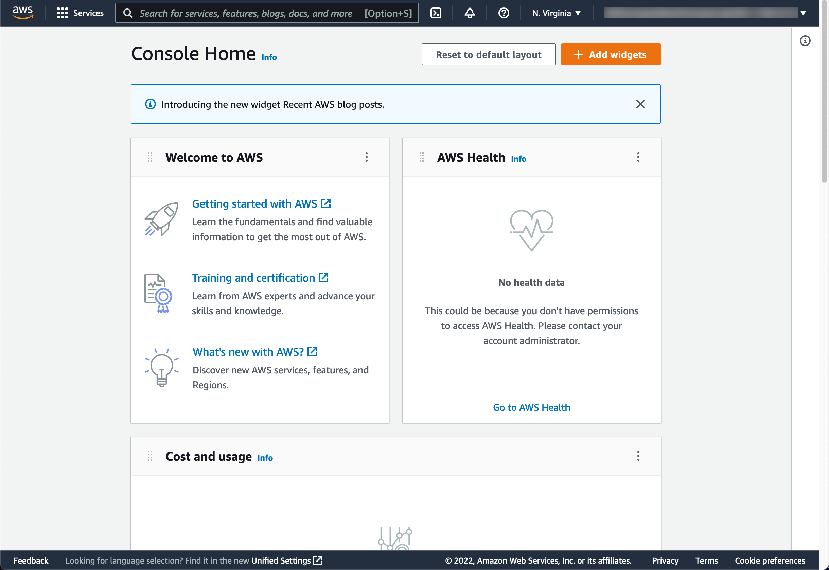
Step 4: Access AWS account
Access the AWS Console, or generate AWS CLI credentials as needed

Slide 13
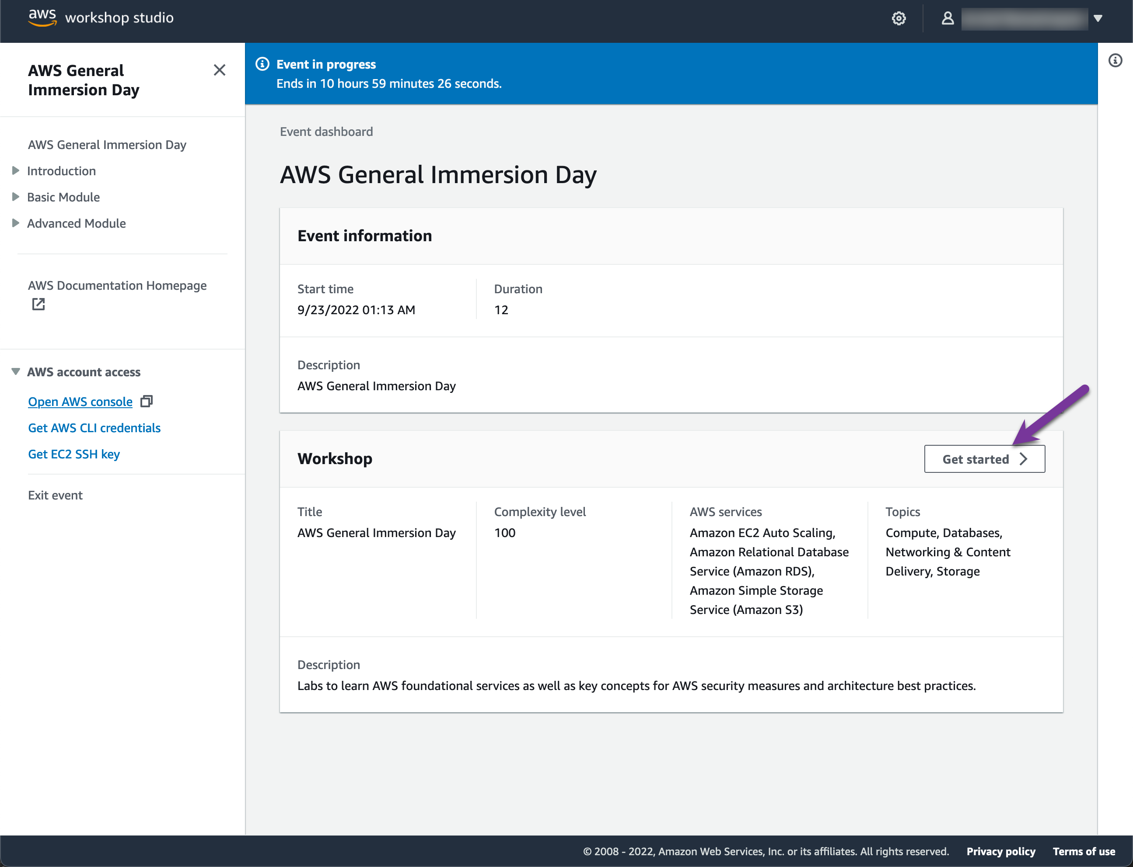
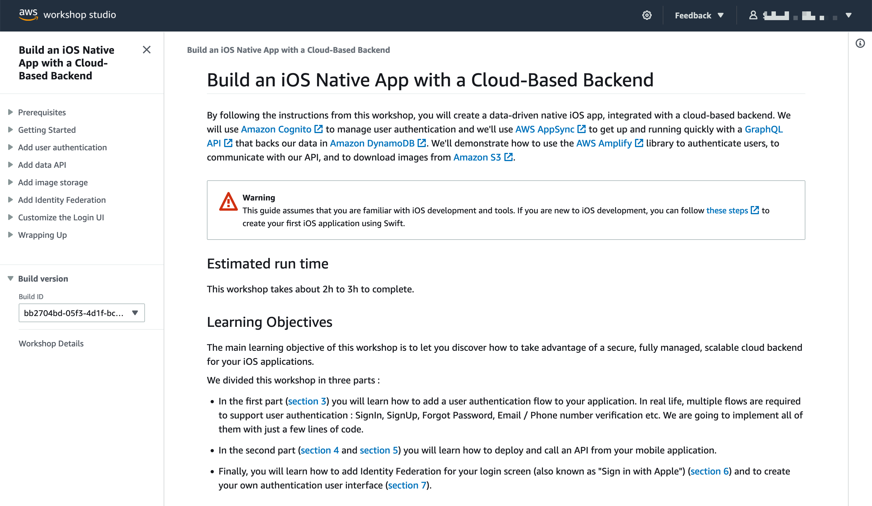
Step 5: Get started with the workshop

Slide 14
Blocked ? A question ? Ask for help !

Slide 15
Sébastien Stormacq
@sebsto

